Slide 1



《Model and Analysis of System》—ROPES
chenbo2008@ustc.edu.cn

Slide 2
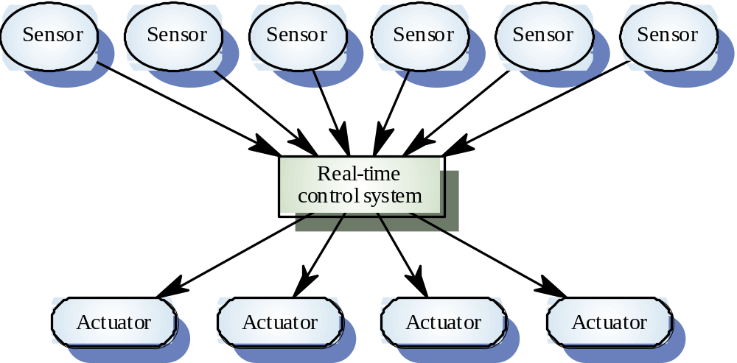
A real-time system model

Slide 3
Development Phases
The development process is divided up into large-scale activities, or phases, in an effort to simplify and clarify what needs to be done and when. These phases are as follows:
  Analysis:consists of identification of the essential characteristics of all possible correct solutions.
  Design:adds the elements to the analysis that define one particular solution on the basis of the optimization of some criteria.
  Translation:creates an executable,deployable realization of the design.
  Testing:verifies that the translation is equivalent to the design and validates that the implementation meets all of the criteria for correctness identified in the analysis.

Slide 4
Development Phases
Each phase of development is allowed to focus on different aspects of the same system, just as architects use different views (floor plans, electrical conduit plans, and plumbing plans, for example) to focus on different aspects of the same building.
The Analysis phase is further divided into the following subphases:
  Requirements analysis
  Systems analysis
  Object analysis.

Slide 5
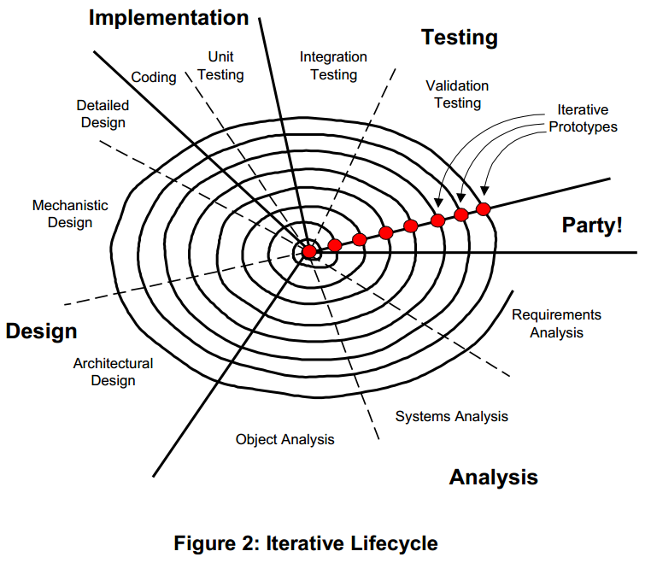
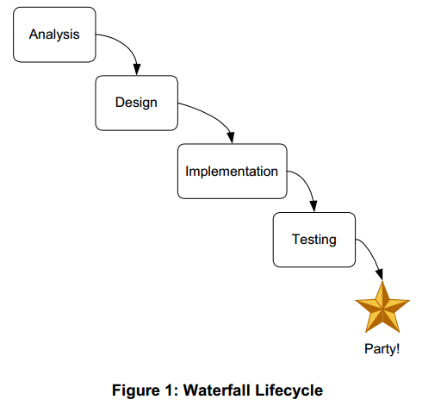
Development Phases
The design phase may likewise be divided into the following subphases:
  Architectural design
  Mechanistic design
  Detailed designs

Slide 6
Prototyping
A prototype is an instance of a system model. In the software context, they are almost always executable in some sense.
Prototypes may be either throw-away or iterative. A throw-away prototype is one which will not ultimately show up in the final product. For example, it is common to use GUI-building tools to construct mock-ups of user interfaces to provide early exposure of a planned interface to a set of users.

Slide 7
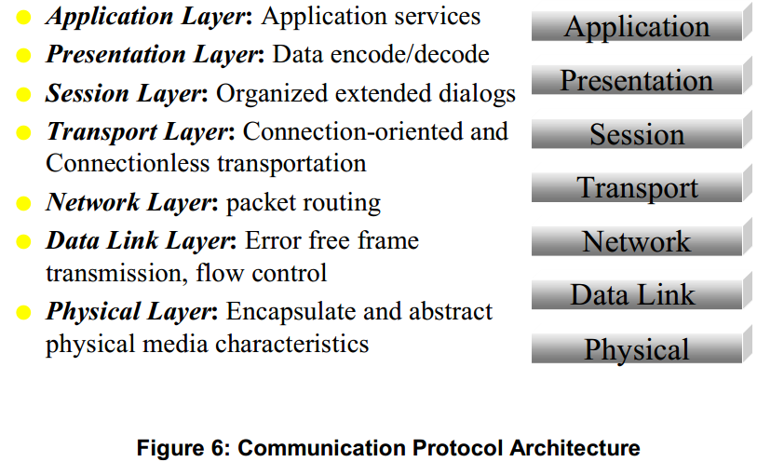
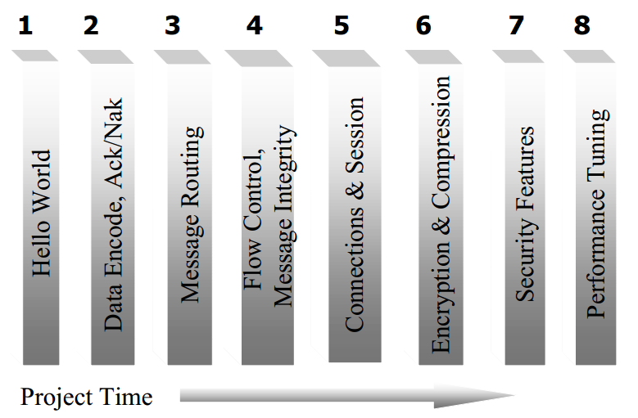
Prototyping
For example, suppose you lead a team that builds an communications protocol which is modeled after the 7-layer ISO communications protocol standard. The layered architecture appears in Figure below.

Slide 8
The ROPES Macro Cycle
The ROPES process is based on an iterative lifecycle which uses the standard UML meta-model for its semantic framework and notation.
It encourages (but does not require) automatic code generation within a real-time framework from its models to facilitate rapid generation of prototypes.

Slide 9
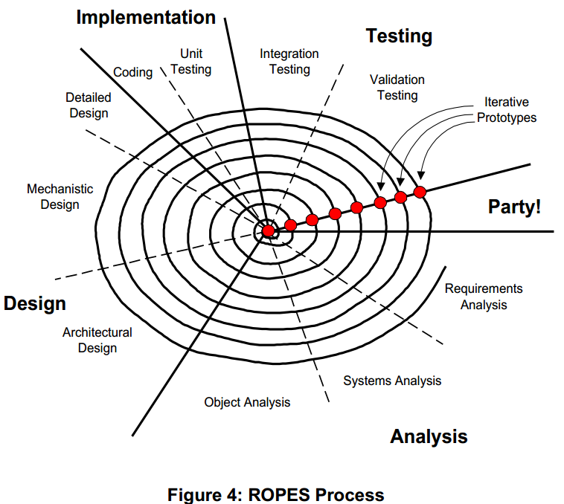
The ROPES Macro Cycle

Slide 10
The ROPES Macro Cycle
The purpose of any process is to improve the product resulting from the process. In particular, the primary purposes of any development process are to do the following:
  increase the quality of the end product;
  improve the repeatability and predictability of the development effort;
  decrease the effort required to develop the end product at the required level of quality;
To achieve its primary purposes, a development process consists of phases, activities, and artifacts.

Slide 11
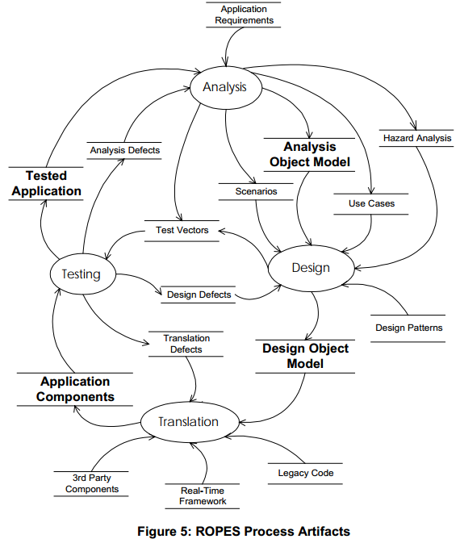
The ROPES Macro Cycle

Slide 12
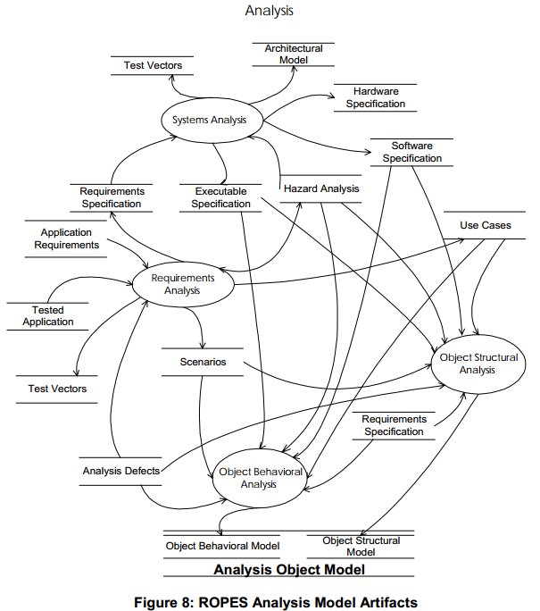
Analysis

Slide 13
Analysis-Requirements Analysis
Requirements analysis extracts requirements from the customer. The customer may be anyone who has the responsibility for defining what the system does. This might be a user, a member of the marketing staff, or a contractor. There are several barriers to the extraction of a complete, unambiguous, and correct set of requirements.

Slide 14
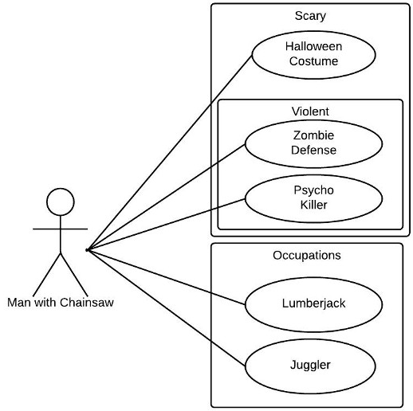
Analysis-Requirements Analysis-Activities
The basic activities of requirements analysis are as follows:
  Identify the use cases and associated actors
  Decompose use cases with the following relations:
    generalization
    uses (or includes)
    extends
  Identify and characterize external events that affect the system
  Define behavioral scenarios that capture system dynamic behavior.
  Identify required constraints:
    required interfaces to other systems
    performance constraints

Slide 15
Analysis-Requirements Analysis-Activities
The first tool is the use case. As mentioned, a use case is a cohesive end-to-end, externally visible behavior of the system. They can often be identified by talking with the customer. Most systems consist of three kinds of use cases:
  Primary use cases are the most obvious and capture typical externally visible functionality.
  Secondary use cases are less common but still identify important piece of functionality.
  Sometimes it is possible to also identify safety-related use cases. Most of the time, however, safety and reliability issues are addressed within the previously mentioned types of use cases. These use cases exist when, in addition to normal functionality, the system also acts as a safety monitor or enabler for another system.

Slide 16
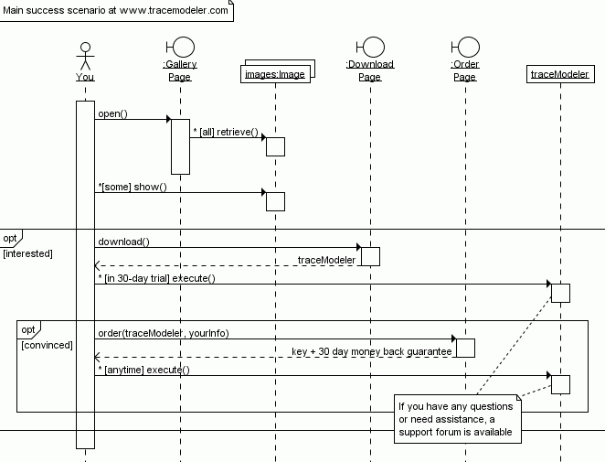
Analysis-Requirements Analysis-Activities
Once use cases are identified, scenarios can be examined in more detail. Remember, scenarios are instances of use cases.
The identification of events relevant to the system and their properties is also done during requirements analysis. This analysis includes the messages and events that actors send to the system and the system response to those messages. The performance properties of each message at this level include the following:

Slide 17
Analysis-Requirements Analysis-Activities
An Associated actor:
  Sender of message
  Receiver of response
An Arrival pattern (periodic or episodic)
An Arrival time for the message:
  Period and jitter for periodic message
  Minimum interarrival interval or burst length for episodic message
The message response properties:
  Deadline for hard deadline message
  Average response time for soft deadline message
Message state information:
  Preconditional invariants for the message
  Protocol (acceptable message sequence)
  Message data
  Postconditional invariants for the response

Slide 18
Analysis-Requirements Analysis-Metamodel Entities Used
Two different kinds of modeling elements are used in requirements analysis: contextual and behavioral.
The contextual elements define the following:
  actors (objects that exist outside the scope of your system)
  the “system object”
  use cases
  use case relations
  external messages (including events)
  hazards

Slide 19
Analysis-Requirements Analysis-Metamodel Entities Used
Behavioral elements include the following:
  constraints, such as
    performance requirements
    fault tolerance times
  statecharts, including
    states
    transitions
  scenarios
  message protocols in actor-system interactions

Slide 20
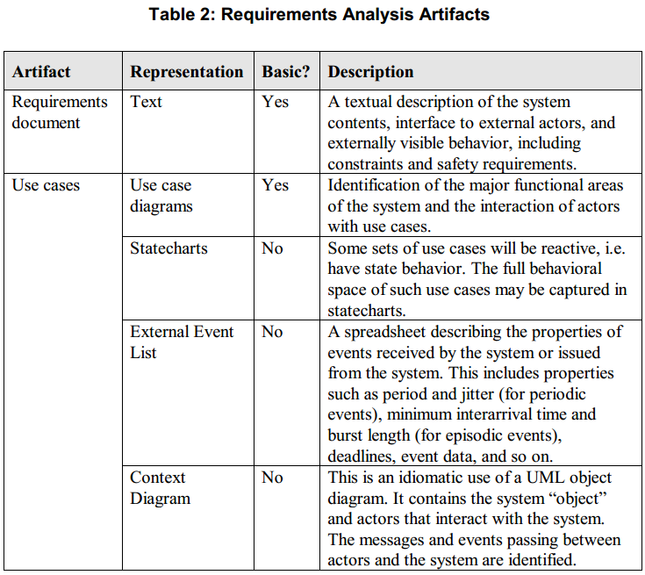
Analysis-Requirements Analysis-Artifacts

Slide 21
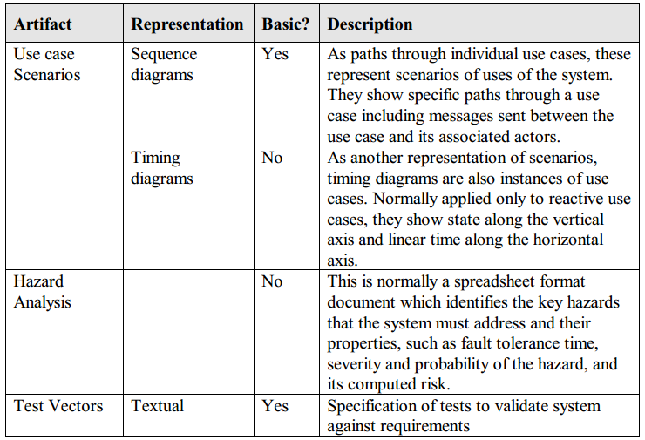
Analysis-Requirements Analysis-Artifacts

Slide 22
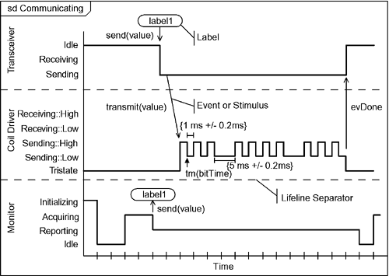
Analysis-Requirements Analysis-Artifacts

Slide 23
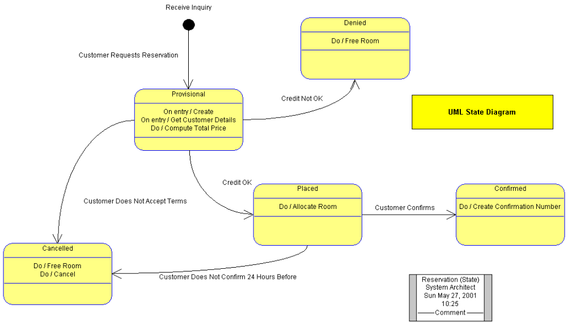
Systems Analysis
Systems analysis is an important phase in large complex real-time systems, such as aerospace and automotive applications. Systems analysis normally elaborates key algorithms and partitions the requirements into electronic, mechanical, and software components. Often, behavioral modeling tools such as Statemate are used to construct executable models and explore system dynamics.

Slide 24
Systems Analysis-Activities
The primary activities of system analysis are to
  identify large-scale organizational units for complex systems;
  build and analyze complex behavioral specifications for the organizational units;
  partition system-level functionality into the three engineering disciplines of
    software
    electronics
    mechanics
  Test the behavior with executable models ;

Slide 25
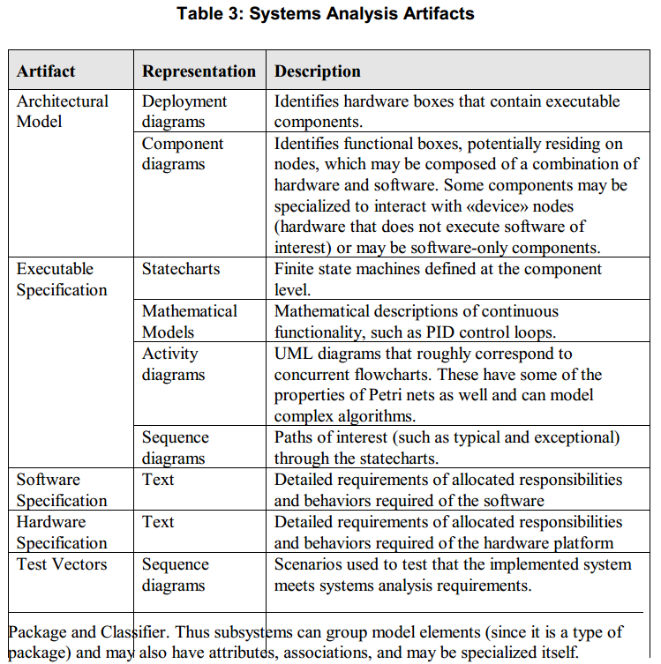
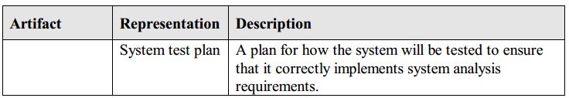
Systems Analysis-Metamodel Entities Used

Slide 26
Systems Analysis-Object Analysis-Activities
The primary activities of object analysis are to
  apply object identification strategies to uncover essential objects of the system;
  abstract the objects to identify classes;
  uncover how the classes and objects relate to each other;
  construct mechanisms of object collaboration that meet the use case behavioral requirements;
  define the essential behavior of reactive objects;
  identify the essential operations and attributes of the objects;
  test the identified mechanisms with scenarios;
  decompose end-to-end performance constraints into performance constraints on class operations;

Slide 27
Systems Analysis-Object Analysis-Activities
Attributes | Behavior | State | Identity | Responsibility
Linear value Rate of change (RoC) | Acquire Report Reset Zero Enable Disable | Last value Last RoC(computed value) | Instance for robot arm joint | Provide information for the precise location of the end of the robot arm with respect to some reference coordinate frame

Slide 28
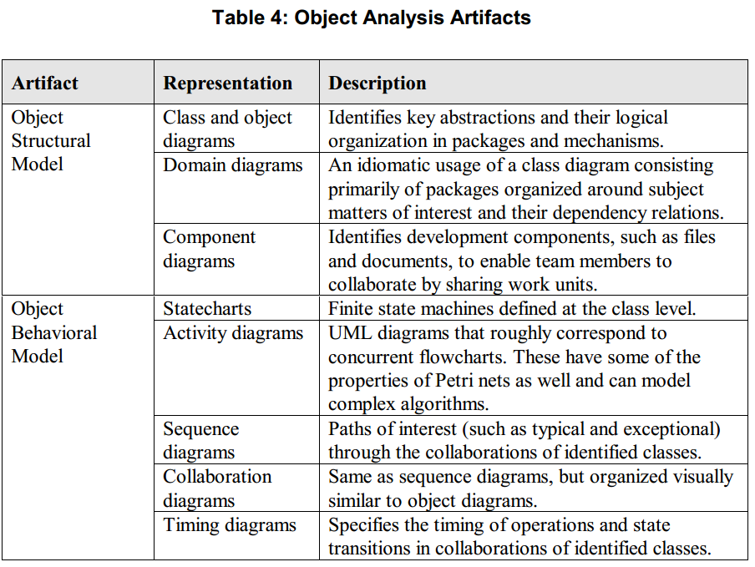
Systems Analysis-Object Analysis-Artifacts

Slide 29
Design
While analysis identifies the logical or essential model of a system, design defines a single particular solution that is in some sense “optimal”. For example, design will identify things like
  Which objects are active (concurrency model);
  Application task scheduling policies;
  Organization of classes and objects within deployable components;
  Interprocessor communication media and protocols;
  Distribution of software components to nodes (esp. if systems analysis step was skipped);
  Relation implementation strategies (How should associations be implemented –pointers? references? TCP/IP sockets?);
  Implementation patterns for state machines;
    Management of multi-valued roles (i.e. 1-* associations);
    Error-handling policies;
    Memory-management policies;

Slide 30
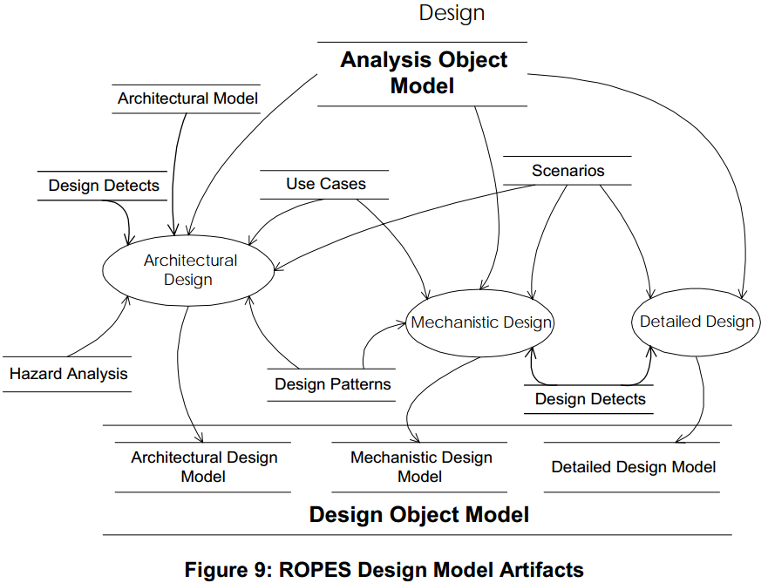
Design

Slide 31
Architectural Design-Activities
The ROPES process identifies five important views of architectures: subsystem and component, concurrency and resource, distribution, safety and reliability and deployment.
The primary activities in architectural design are the
  Identification and characterization of threads;
  Definition of software components and their distribution;
  Application of architectural design patterns for
    global error handling;
    safety processing;
    fault tolerance ;

Slide 32
Architectural Design-Metamodel Entities Used
Since the design model is an elaboration of the analysis model, it consists of the same set of elements. The basic elements are collaborations, classes, objects, and their relations. Of particular concern in architectural design are the nodes, components, and active classes. Nodes and components capture the physical deployment architecture. Active objects are objects which are the root of threads. They form the basis of the UML concurrency model.

Slide 33
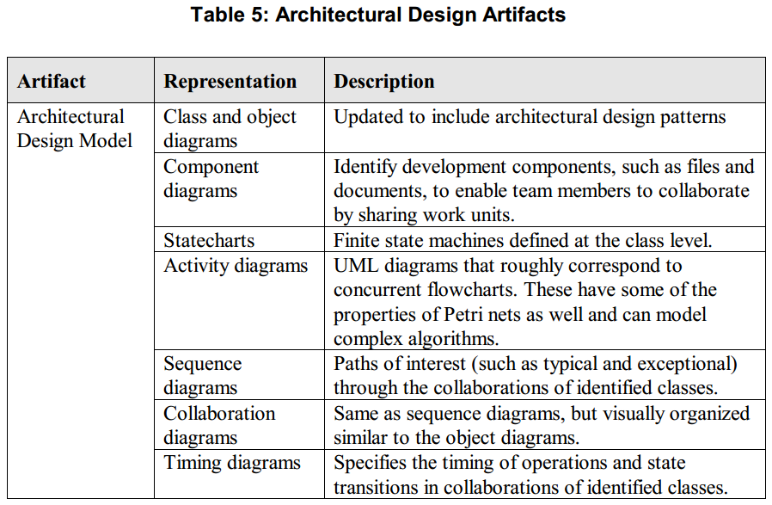
Architectural Design-Artifacts

Slide 34
Mechanistic Design-Activities
In mechanistic design, the details of collaborations of objects are refined by adding additional objects. For example, if a controller must manage many pending messages, the Container-Iterator pattern can be applied. This results in the insertion of a container (such as a FIFO queue to hold the messages) and iterators which allow the manipulation of that container. The container and iterator classes serve as “glue” to facilitate the execution of the collaboration.

Slide 35
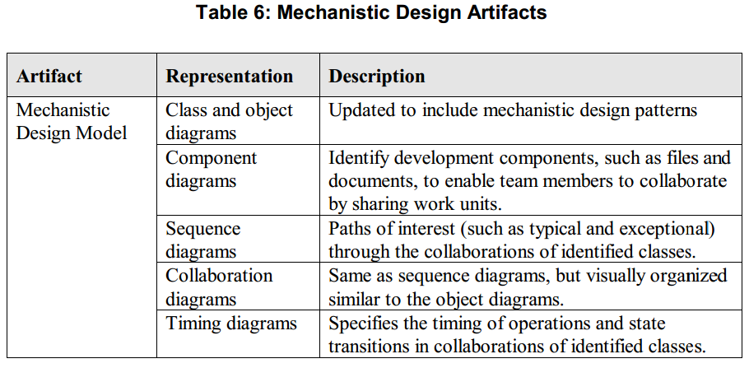
Mechanistic Design-Artifacts

Slide 36
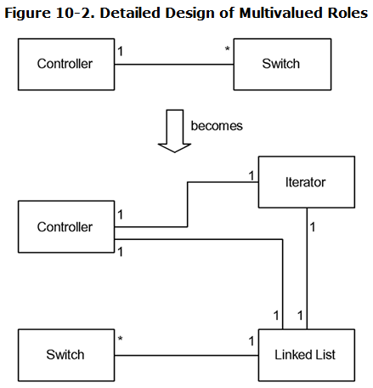
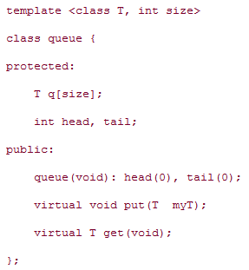
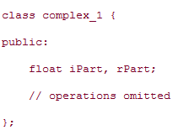
Detailed Design
Detailed design is the lowest level of design. It is concerned with the definition of the internal structure and behavior of individual classes.

Slide 37
Detailed Design-Activities
Most classes in a typical system are simple enough not to require much detailed design. However, even there, the implementation of associations, aggregations, and compositions must be defined. Additionally, the pre- and post-conditional invariants of the operations, the exception-handling model of the class, and the precise types and valid ranges of attributes must be specified. For some small set of classes, complex algorithms must be clarified.

Slide 38
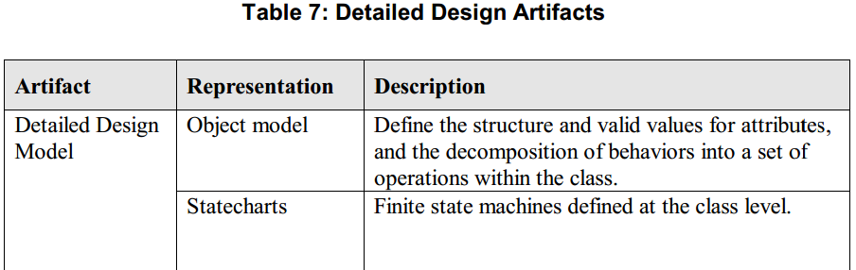
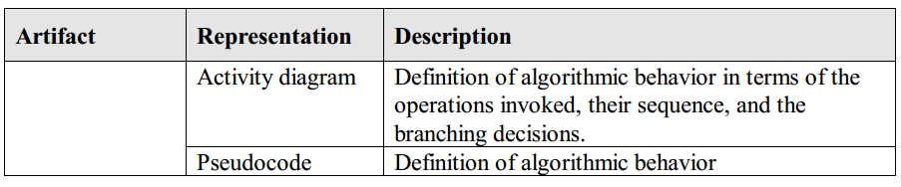
Detailed Design-Artifacts

Slide 39
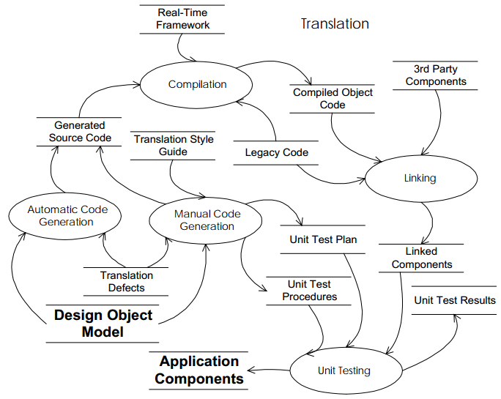
Translation
The translation phase turns the UML model into source code, and, via the compiler, into an executable system as depicted in Figure below.

Slide 40
Translation-Activities
In a translative development micro cycle, translation happens more or less automatically. In the elaborative approach, the developer must map the UML model elements to programming language elements. If an object-oriented language is used, this process is fairly rote because all the important decisions have already been made during analysis and design. If a non-object-oriented language is used, then the programming effort is more “creative.” In this case, it is common to write a translation style guide. This guide defines the translation rules to be used for the programmer to implement the UML model in the target language, whether it is C, Pascal, or assembly language.

Slide 41
Translation-Activities
The ROPES process also includes unit testing in this phase. Unit testing is a set of whitebox tests that ensure that the unit under test is, in fact, internally correct and meets the design. This normally consists of Unit Test Plan and Unit Test Procedures documents, and culminates in a Unit Test Results document. The Unit Test Plan is normally organized around the basic unit of the class. The document is normally written at the package or component level.

Slide 42
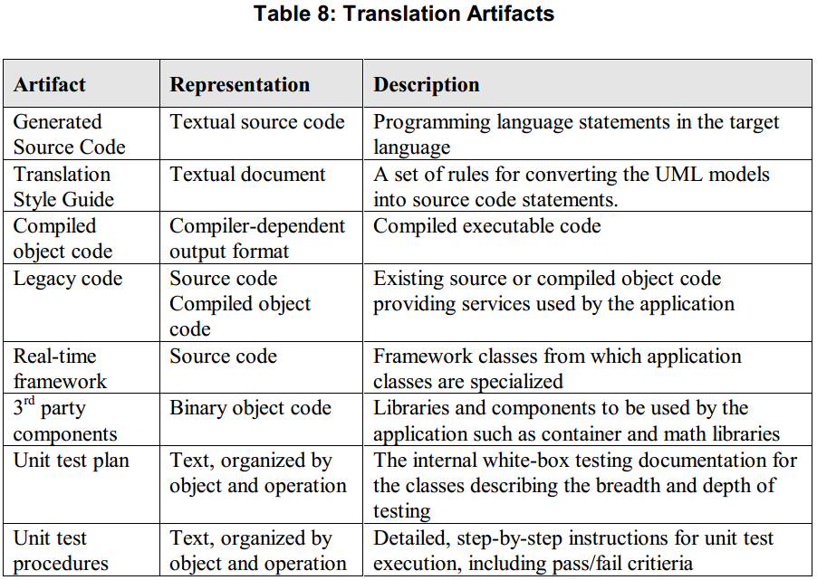
Translation-Artifacts

Slide 43
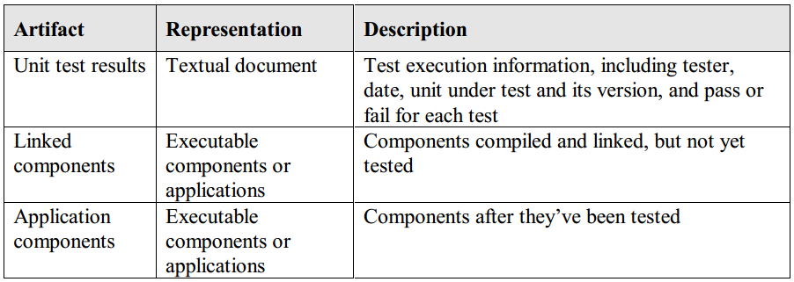
Translation-Artifacts

Slide 44
Testing
The testing phase in the ROPES process includes both integration and validation testing. Testing applies a set of test vectors to the application that have observable results. The test vectors are based primarily upon the scenarios identified in the requirements and object analysis phase. The resulting artifacts are a tested application and revealed defects.

Slide 45
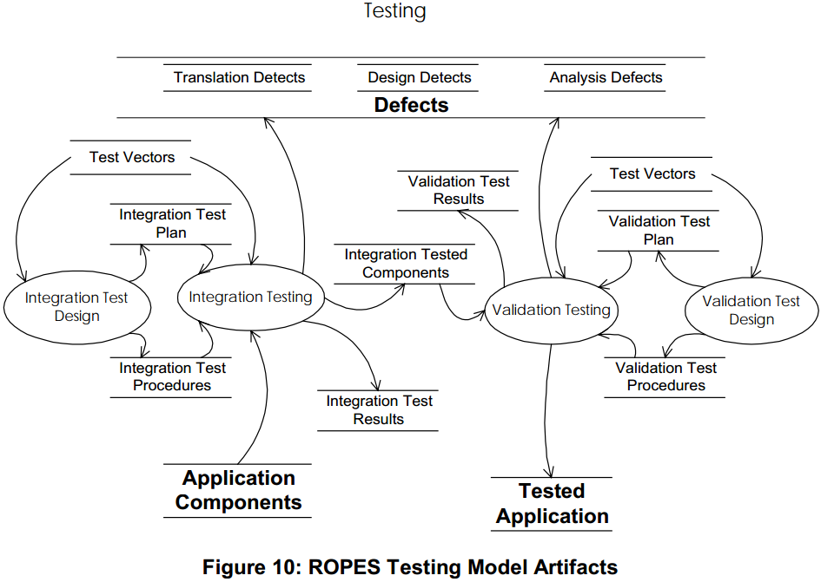
Testing

Slide 46
Testing-Activities
All tests should be executed against a test plan and in strict accordance with a test procedures document. In integration testing, the system is constructed by adding a component at a time. At each point where a new component is added, the interfaces created by adding that component are tested. Validation tests are defined by a test team and represent the set of requirements and system analysis done early on. Validation tests are fundamentally black box. The only exceptions are the tests of the safety aspects. These tests are white box because it is usually necessary to go inside the system and break something to ensure that the safety action is correctly executed.

Slide 47
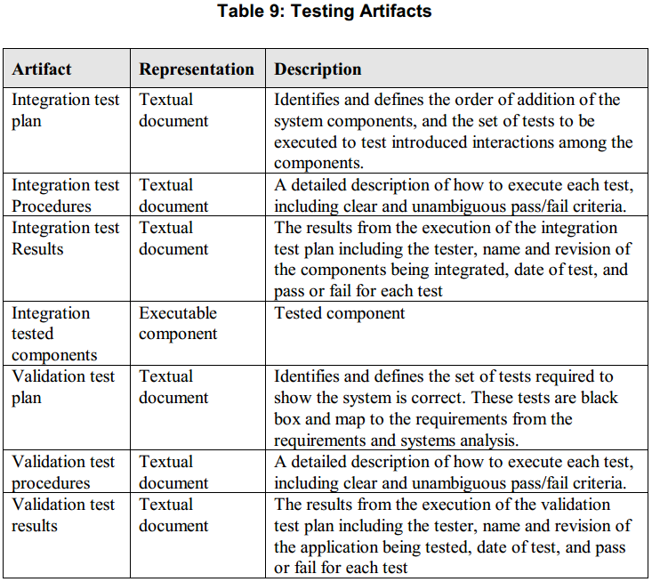
Testing-Artifacts

Slide 48
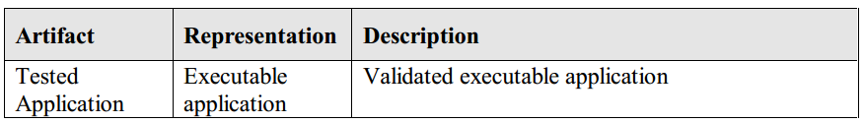
Testing-Artifacts

Slide 49
Summary
The phases identified in the ROPES model are organized into an iterative lifecycle. Each prototype typically implements one or more use cases, organized by risk (greater risk first). This allows the early exploration of risks and minimizes the number of model aspects that must be modified due to those risks. In order to explore those risks, executable prototypes must be developed, since only executable things can be tested. Thus, the key enabling technology which makes this process rapid and efficient is the automatic translation of models into executable code. This reduces the time necessary to do complete iterations from weeks or months to hours or days. ROPES supports both elaborative and translative development micro cycles, but leans towards the latter.

